Slide 1

Prepared by,
Sai Nikhilesh Kasturi

Slide 2
AGENDA
What is Data Analytics
SQL overview
Why SQL
Why not Python? R?
Components of SQL
RDBMS Overview
Overview about Joins
Questions

Slide 3
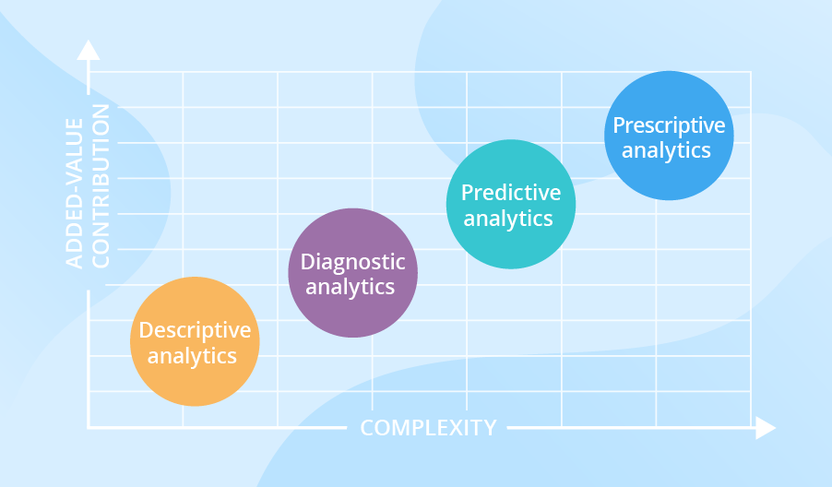
What is Data Analytics ?
Descriptive analytics describes what has happened over a given period of time. Have the number of views gone up? Are sales stronger this month than last?
Diagnostic analytics focuses more on why something happened. This involves more diverse data inputs and a bit of hypothesizing. Did the weather affect beer sales? Did that latest marketing campaign impact sales?
Predictive analytics moves to what is likely going to happen in the near term. What happened to sales the last time we had a hot summer? How many weather models predict a hot summer this year?
Prescriptive analytics suggests a course of action or a decision. If the likelihood of a hot summer is measured as an average of these five weather models is above 58%, we should add an evening shift to the brewery and rent an additional tank to increase output.

Slide 4
SQL Overview
SQL is Structured Query Language, which is a computer language for storing, manipulating and retrieving data stored in a relational database.
SQL is an ANSI (American National Standards Institute) standard language, but there are many different flavors of the SQL language.
SQL is the standard language for Relational Database System. All the Relational Database Management Systems (RDMS) like MySQL, MS Access, Oracle, Sybase, Informix, Postgres and SQL Server use SQL as their standard database language.
Different dialects, such as −
T-SQL used for MS SQL Server.
PL/SQL used for Oracle.
T-SQL | PL/SQL
T-SQL is a Microsoft product. | PL-SQL is developed by Oracle.
Full Form of TL SQL is Transact Structure Query language. | Full Form of PL SQL is Procedural Language Structural Query Language.
It is easy and simple to understand. | PL-SQL is complex to understand.

Slide 5
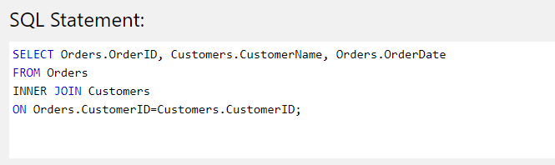
Why SQL?
Simple
Accessible
Applicable
Powerful
Universal
Why is SQL the foundation of Data Analytics?
Data engineers and database administrators will use SQL to ensure that everybody in their organization has access to the data they need.
Data scientists will use SQL to load data into their models.
Data analysts will use SQL to query tables of data and derive insights from it.

Slide 6

Why not Python? R ?
Difficult for beginners
Complicated syntax
Requires programming knowledge (logic, algorithms)
Is SQL better than Python or R?
SQL is good for some things and Python/R is good for other things
Compliment each other
SQL is a great starting point

Slide 7
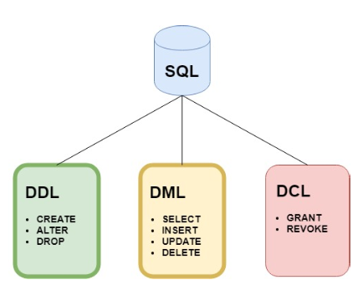
Components of SQL
SQL consists of three components which offer everything required to manage, maintain and use a database.
1. Data Definition Language. (DDL)
2. Data Manipulation Language. (DML)
3. Data Control Language. (DCL)

Slide 8
Data Definition Language (DDL)
This component is used to define the structure (or schema) of the database.
For tables there are three main commands:
Command | Description
CREATE | Creates a new table, a view of a table, or other object in the database.
ALTER | Modifies an existing database object, such as a table.
DROP | Deletes an entire table, a view of a table or other objects in the database.
Data Manipulation Language (DDL)
This component is used to manipulate data within a table.
There are four main commands:
Command | Description
SELECT | Retrieves certain records from one or more tables.
INSERT | Creates a record.
UPDATE | Modifies records.
DELETE | Deletes records.

Slide 9
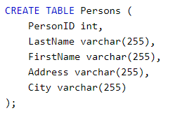


Examples !
What will be the Output for the above command ?
What will be the Output for the above command ?
What will be the Output for the above command ?

Slide 10
What is RDBMS?
RDBMS stands for Relational Database Management System. RDBMS is the basis for SQL, and for all modern database systems like MS SQL Server, IBM DB2, Oracle, MySQL, and Microsoft Access.
A Relational database management system (RDBMS) is a database management system (DBMS) that is based on the relational model as introduced by E. F. Codd.
Database Terminology
Table: The data in an RDBMS is stored in database objects which are called as tables.
Field: Every table is broken up into smaller entities called fields. The fields in the Persons table consist of PersonID, LastName, FirstName etc.
Record: A record is also called as a row of data is each individual entry that exists in a table.
Primary Key – unique and mandatory
Foreign Key – a cross-reference between tables because it references the primary key of another table.
Relationship – created though foreign keys.

Slide 11
Data Integrity
The following categories of data integrity exist with each RDBMS −
Entity Integrity − There are no duplicate rows in a table.
Domain Integrity − Enforces valid entries for a given column by restricting the type, the format, or the range of values.
Referential integrity − Rows cannot be deleted, which are used by other records.
Database Normalization
Database normalization is the process of efficiently organizing data in a database. There are two reasons of this normalization process −
Eliminating redundant data, for example, storing the same data in more than one table.
Ensuring data dependencies make sense.
Normalization guidelines are divided into normal forms. The aim of normal forms is to organize the database structure.
First Normal Form (1NF)
Second Normal Form (2NF)
Third Normal Form (3NF)

Slide 12
Database Normalization With Example
Database Normalization Example can be easily understood with the help of a case study. Assume, Steam maintains a database of games rented out. Without any normalization in database, all information is stored in one table as shown below. Let's understand Normalization in database with tables example:
Name | Address | Games Rented | Salutation
Ajay | Estates of Frankford, Apt: 44, Dallas, TX | CSGO, PUBG | Mr.
Marie | Chatham Reflections, Apt: 12, Dallas, TX | COD | Miss.
Ajay | Pearl, Apt: 123, Dallas, TX | FIFA, COD | Mr.
Here you see Games Rented column has multiple values. Now let's move into 1st Normal Forms:
1NF (First Normal Form) Rules
Each table cell should contain a single value.
Each record needs to be unique.

Slide 13
The above table in 1NF-
1NF Example
Name | Address | Games Rented | Salutation
Ajay | Estates of Frankford, Apt: 44, Dallas, TX | CSGO | Mr.
Ajay | Estates of Frankford, Apt: 44, Dallas, TX | PUBG | Mr.
Ajay | Pearl, Apt: 123, Dallas, TX | FIFA | Mr.
Ajay | Pearl, Apt: 123, Dallas, TX | COD | Mr.
Marie | Chatham Reflections, Apt: 12, Dallas, TX | COD | Miss.
Here what is a Primary Key ?
What is Composite Key?
A composite key is a primary key composed of multiple columns used to identify a record uniquely
In our database, we have two people with the same name Ajay, but they live in different places.
Hence, we require both Name and Address to identify a record uniquely. That is a composite key.

Slide 14
2NF (Second Normal Form) Rules
Rule 1- Be in 1NF
Rule 2- Single Column Primary Key, which we don’t have. We have a composite primary key.
It is clear that we can't move forward to make our simple database in 2nd Normalization form unless we partition the table above.
Membership ID | Name | Address | Salutation
123 | Ajay | Estates of Frankford, Apt: 44, Dallas, TX | Mr.
456 | Ajay | Pearl, Apt: 123, Dallas, TX | Mr.
789 | Marie | Chatham Reflections, Apt: 12, Dallas, TX | Miss.
Table 1
We have divided our 1NF table into two tables viz. Table 1 and Table2. Table 1 contains member information. Table 2 contains information on games rented.
We have introduced a new column called Membership_id which is the primary key for table 1. Records can be uniquely identified in Table 1 using membership ID
In Table 2, Membership_ID is the Foreign Key
Membership ID | Games Rented
123 | CSGO
123 | PUBG
456 | FIFA
456 | COD
789 | COD
Table 2

Slide 15
Why do you need a foreign key?
Suppose, a novice inserts a record in Table 2 such as using a command :
Insert a record in table 2 where Membership ID = 444
Membership ID | Games Rented
444 | GOD OF WAR
But Membership ID 444 is not present in table 1. What will happen then ?
Database will throw an error. This is an example of referential Integrity.
What are transitive functional dependencies?
A transitive functional dependency is when changing a non-key column, might cause any of the other non-key columns to change
Consider the table 1. Changing the non-key column Full Name may change Salutation.

Slide 16
3NF (Third Normal Form) Rules
Rule 1- Be in 2NF
Rule 2- Has no transitive functional dependencies.
To move our 2NF table into 3NF, we again need to again divide our table.
Membership ID | Name | Address | Salutation ID
123 | Ajay | Estates of Frankford, Apt: 44, Dallas, TX | 1
456 | Ajay | Pearl, Apt: 123, Dallas, TX | 1
789 | Marie | Chatham Reflections, Apt: 12, Dallas, TX | 2
We have again divided our tables and created a new table which stores Salutations.
There are no transitive functional dependencies, and hence our table is in 3NF.
In Table 3 Salutation ID is primary key, and in Table 1 Salutation ID is foreign to primary key in Table 3.
Salutation ID | Salutation
1 | Mr.
2 | Miss
3 | Dr.
Table 3

Slide 17
What is a join?
A SQL join is a Structured Query Language (SQL) way of linking data from two or more tables based on a column shared between the tables. For example, you might connect an address table and a phone numbers table based on the person’s name (e.g., “Give me the address and phone number for the person named John Smith.”).

Slide 18
Why are joins important?
Joins allow you to gather data from multiple tables using one query. It’s unlikely that you’ll work exclusively with one table. Having one table means that you’re either limiting yourself regarding the amount of data you gather. Or, having so much data that the table becomes unwieldy. Joins relate one table to another (hence the term relational database).

Slide 19
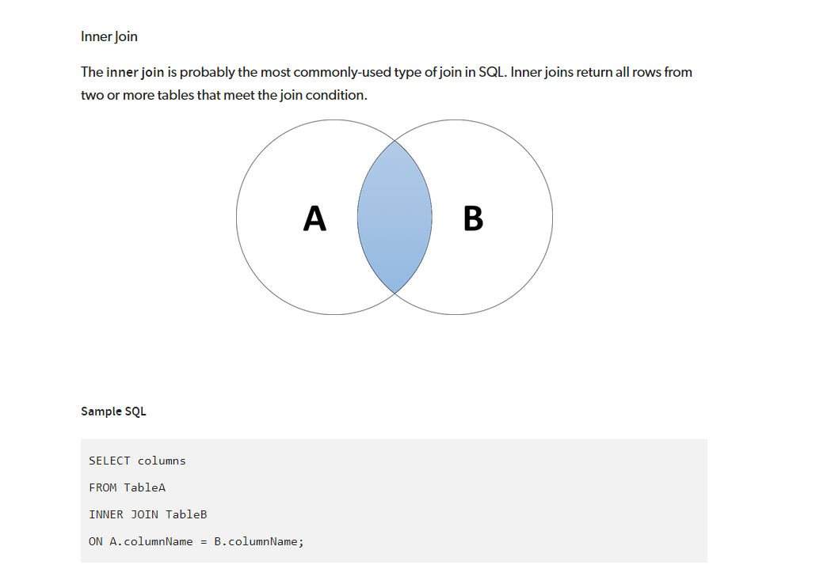

Slide 20
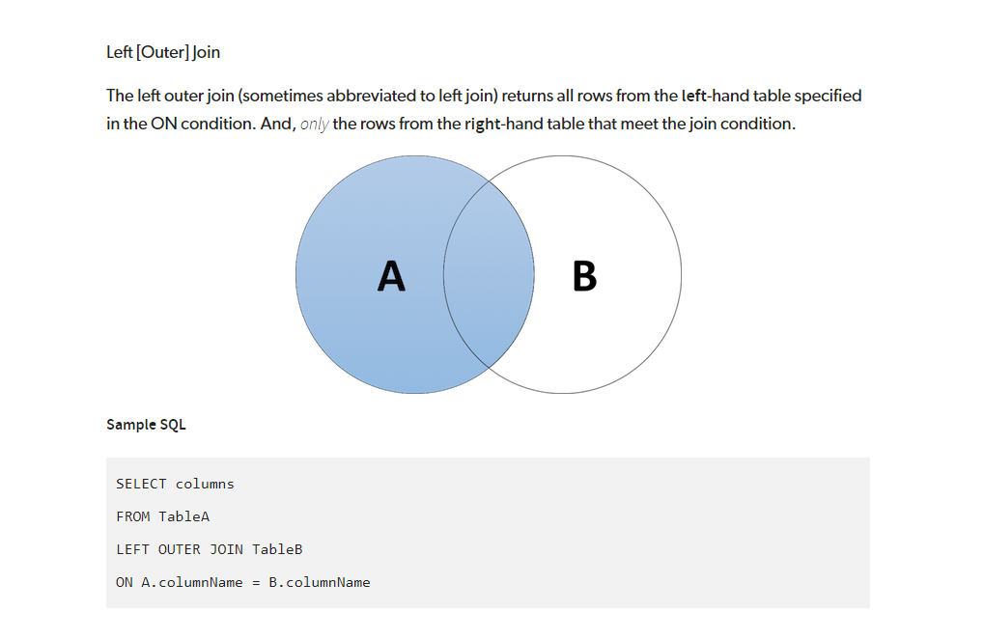

Slide 21
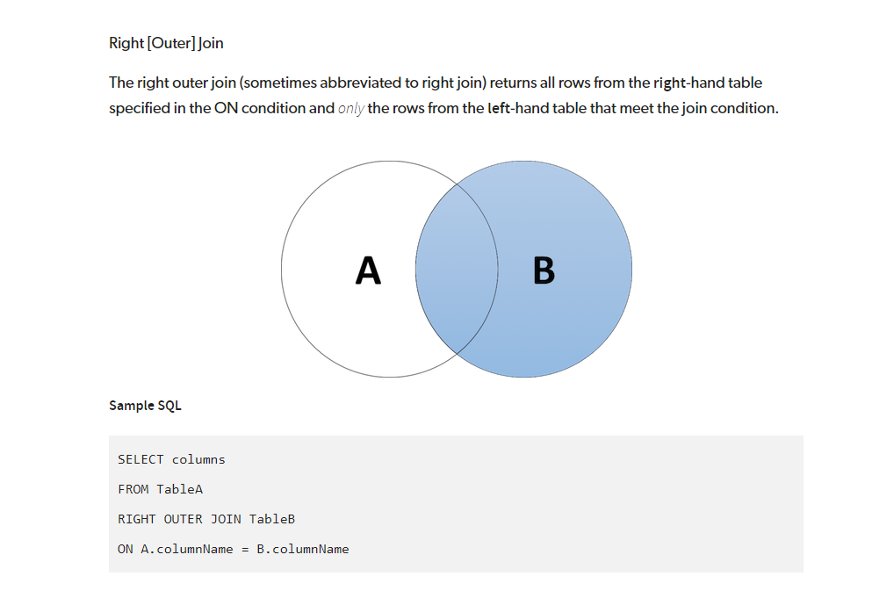

Slide 22
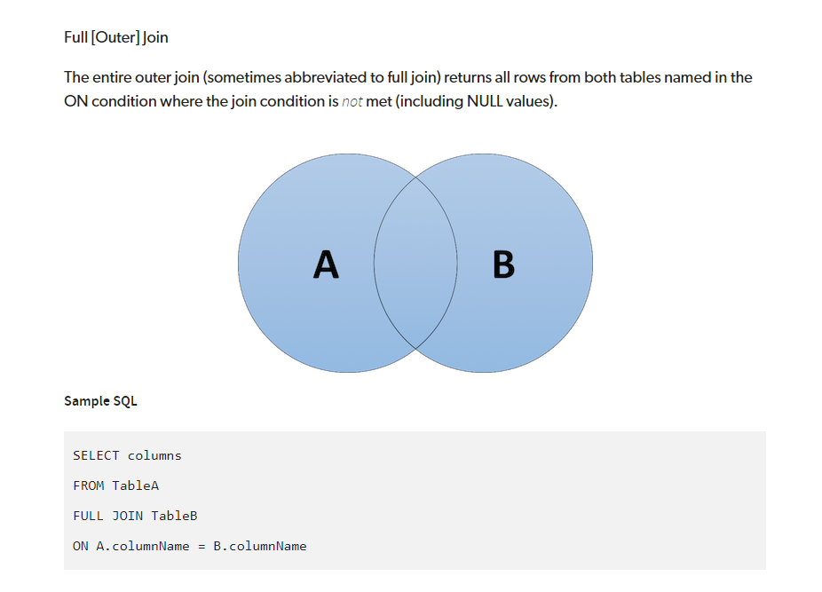

Slide 23


